Slide 1
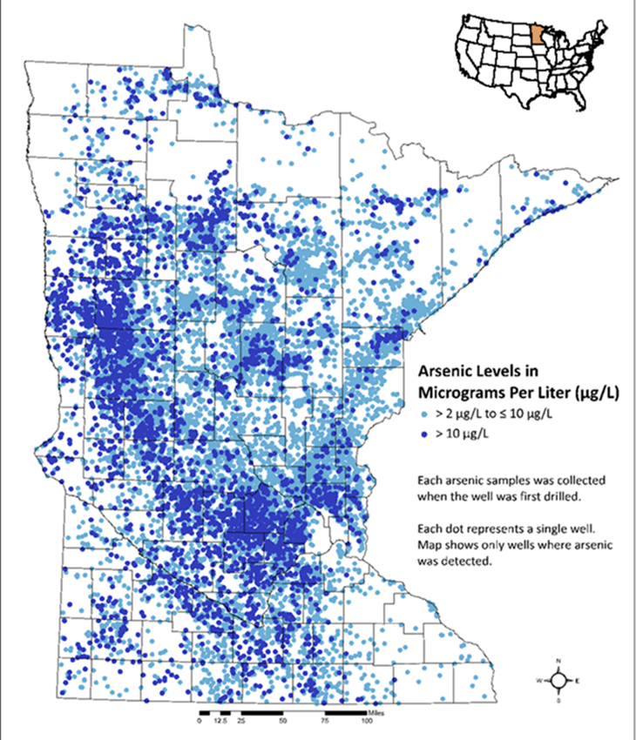
Arsenic in Minnesota groundwater: What can we do about it?
Melinda L. Erickson, PhD, PE (she/her)
Research Hydrologist
U.S. Geological Survey

Slide 2
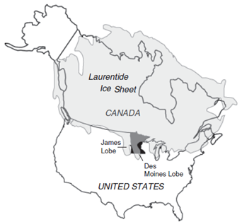
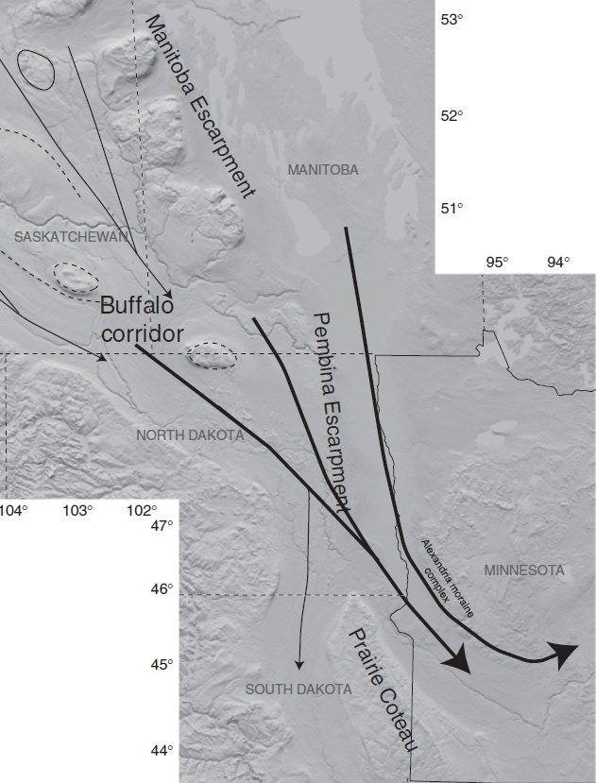
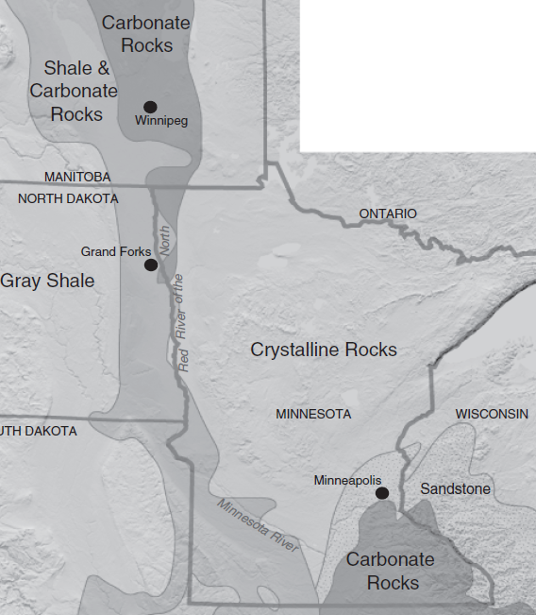
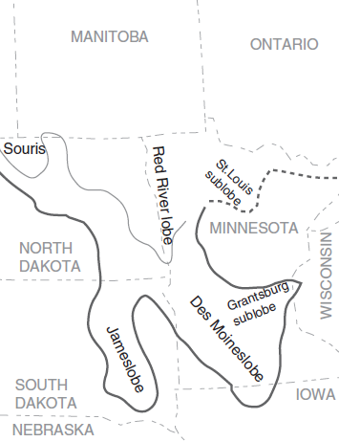
Arsenic in Minnesota’s drinking water aquifers: How did it get there?
Source for graphics: Lusardi et al., 2011

Slide 3
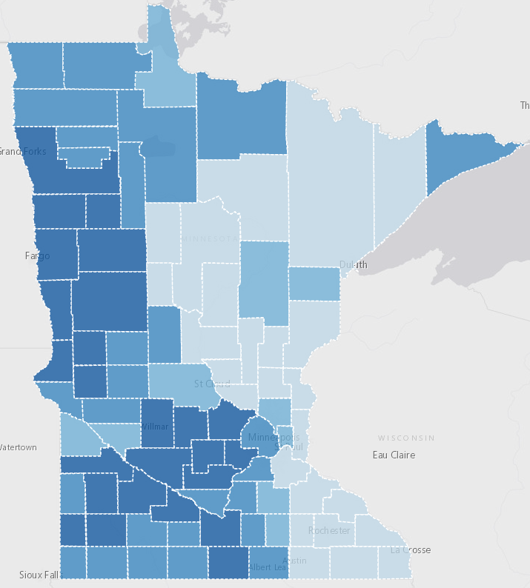
Arsenic in Minnesota’s drinking water aquifers
Risks: cancers, neuropathy, other
EPA standard: 10 μg/L (goal 0 μg/L)
Since 2008, new drinking water wells tested for arsenic
About 60K new wells tested so far
≈11% >10 μg/L arsenic
≈47% >2 μg/L arsenic
About 1 million MN domestic wells
≈150,000 domestic well users >10 μg/L
>500,000 > 2 μg/L
Sources: MN Department of Health, US Environmental Protection Agency
Source: MN Department of Health website at
https://mndatamaps.web.health.state.mn.us/interactive/wells.html

Slide 4
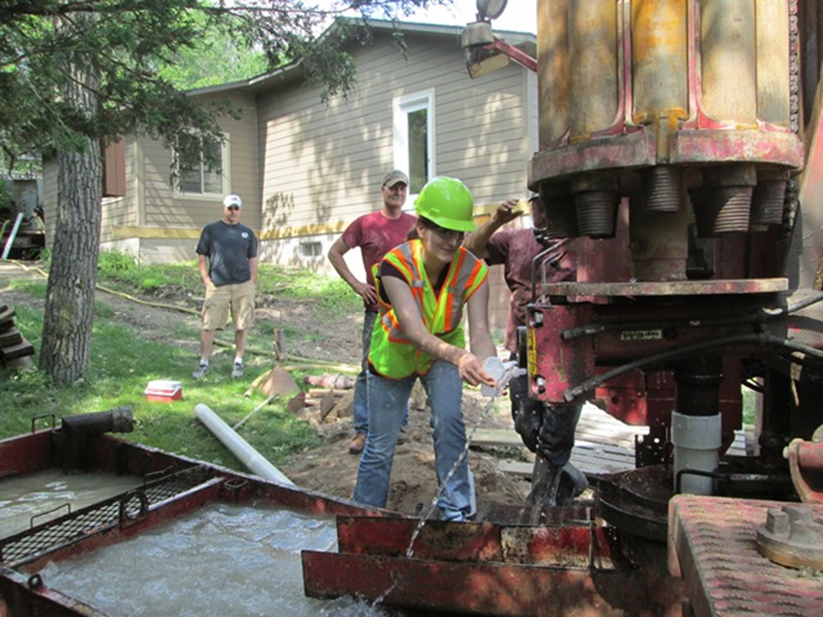
What have we studied so far?
How does the process of well drilling affect aquifer geochemistry?
Do arsenic concentrations change over time?
How do sampling methods affect arsenic measurements?
What well construction choices affect arsenic?
Sample collection from a new drinking water well Erickson et al., 2018a; 2019

Slide 5
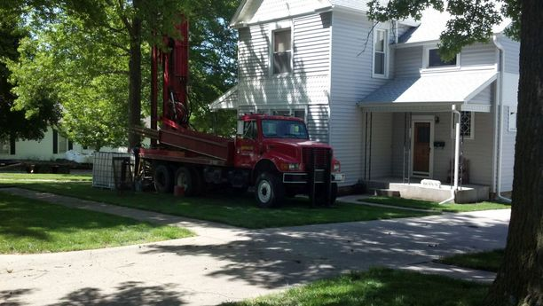
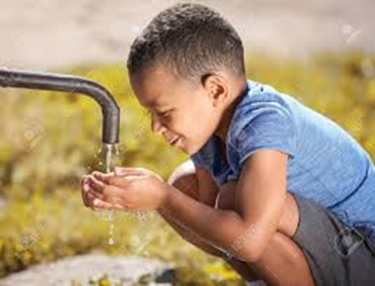
What have we learned so far?
Well drilling disturbs aquifer geochemistry for more than one year
Arsenic concentrations go up over time in many new wells
Sampling protocols influence variability in measured arsenic concentration
Very high arsenic concentrations happen sometimes
Erickson et al., 2018, 2019, 2021

Slide 6
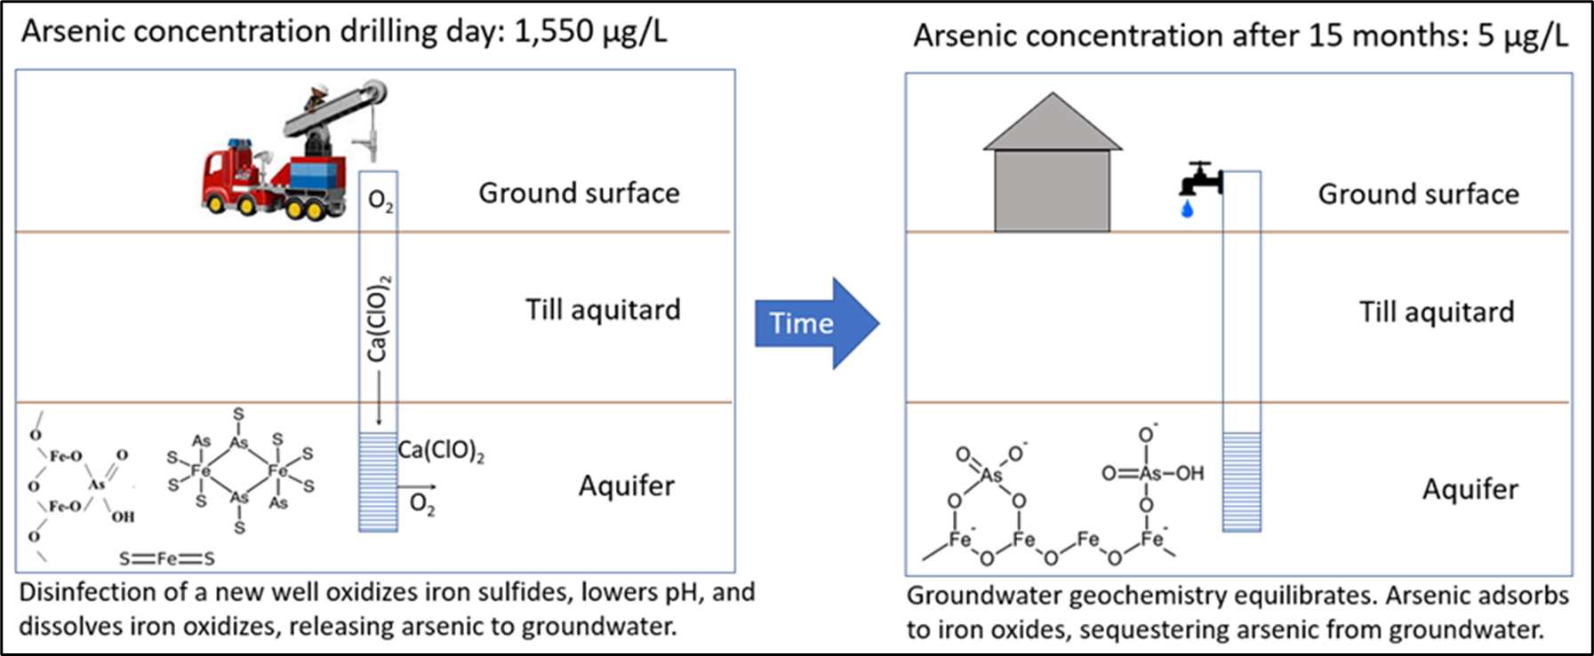
What have we learned?
Erickson et al, 2021, J. Hazardous Materials - Virtual Special issue Managing arsenic in the environment: From source to sink

Slide 7
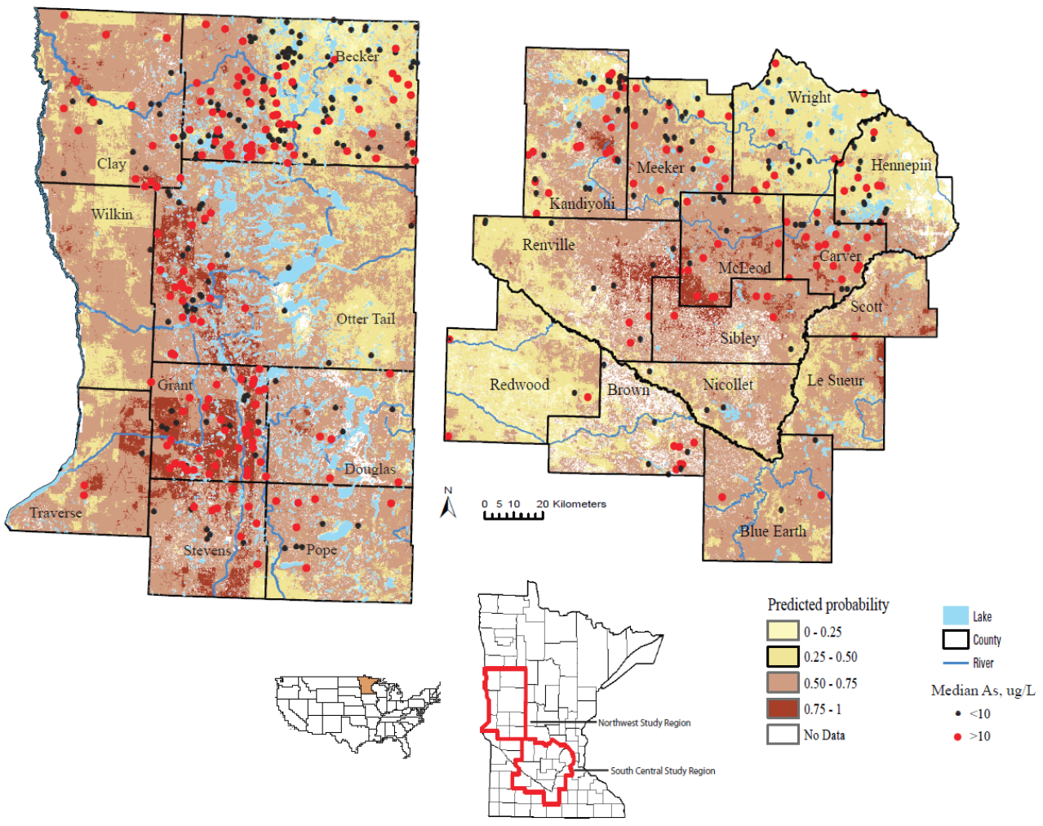
What have we learned?2
Clay gap (length)
Screen length
Erickson 2005
Erickson et al., 2018b

Slide 8
What could we do next?
Domestic well owner education
Well driller education
Domestic well testing opportunities
Domestic well water treatment
More detailed aquifer and arsenic risk mapping

Slide 9
Acknowledgements
Funding
State of Minnesota Clean Water Fund
U.S. Geological Survey Cooperative Matching Fund
National Science Foundation Graduate Research Internship
MN Department of Health sampling: Emily Berquist, Jeff Grugel, Chris Prokosch, Sandra Beck, and Kara Dennis
MDH Public Health Laboratory and USGS National Water Quality Laboratory
Well owners and well drillers

Slide 10
Questions?
Melinda (Mindy) Erickson, merickso@usgs.gov
Cited references:
Erickson ML et al. . 2018a. How or when samples are collected affects measured arsenic concentration in new drinking water wells. https://onlinelibrary.wiley.com/doi/abs/10.1111/gwat.12643.
Erickson, ML et al. 2018b. Predicting geogenic arsenic in drinking water wells in glacial aquifers, north-central USA: accounting for depth-dependent features. https://doi.org/10.1029/2018WR023106.
Erickson ML et al. 2019. Arsenic concentrations after drinking water well installation: Time-varying effects on arsenic mobilization. https://doi.org/10.1016/j.scitotenv.2019.04.362
Erickson, ML et al. 2021. Acute and chronic arsenic hazards in newly drilled domestic wells: short- and long-term drinking water quality implications. https://doi.org/10.1016/j.jhazmat.2021.125409
Erickson, ML. 2005. Arsenic in upper Midwest ground water: occurrence and geochemical mobilization mechanisms, PhD Dissertation, U of MN.
Lusardi et al., 2011. Provenance of Des Moines lobe till records ice-stream catchment evolution during Laurentide deglaciation. https://doi.org/10.1111/j.1502-3885.2011.00208.x

